Slide 1
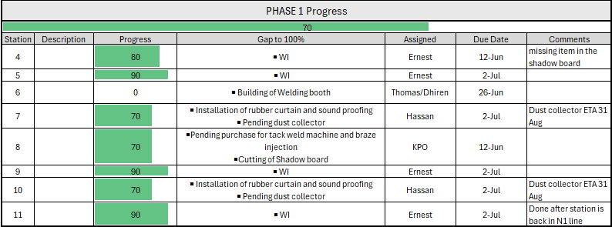
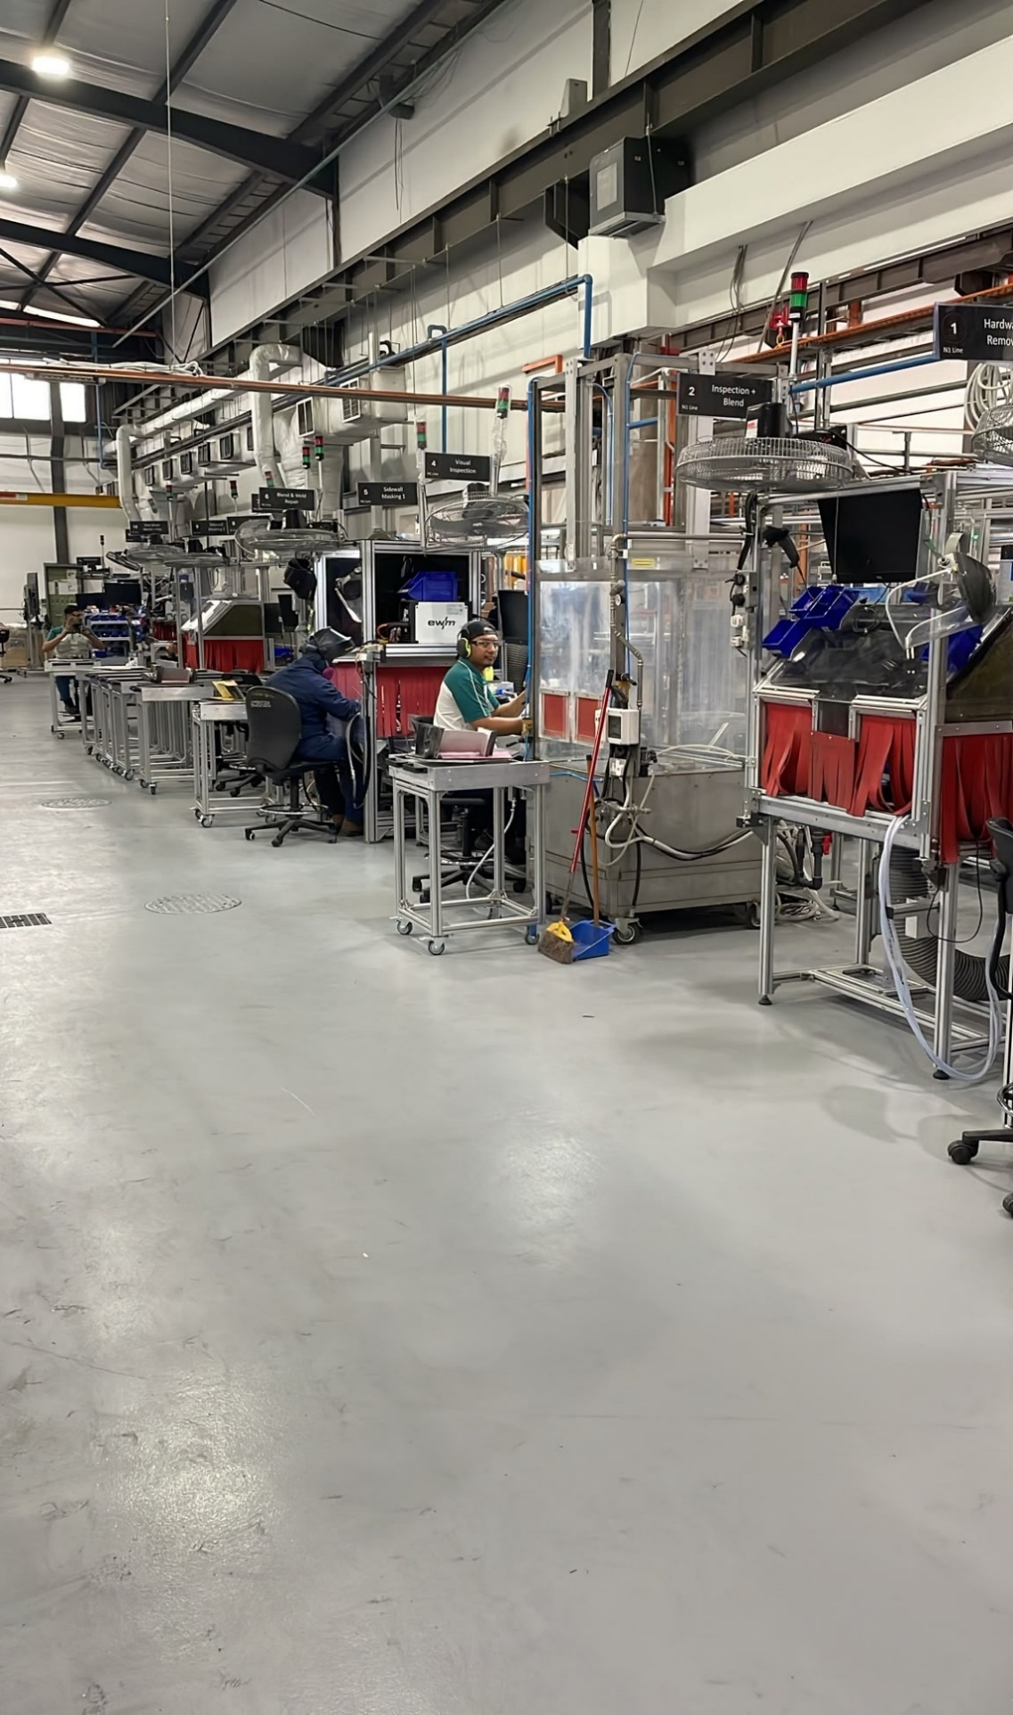
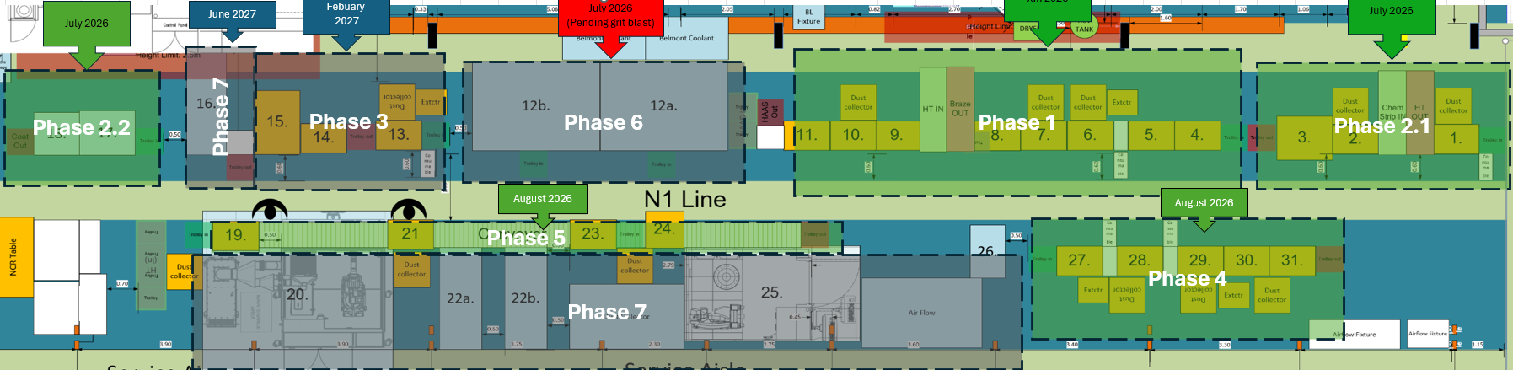



Industry experience
Ernest Sim
ID: 2401326
Operation Engineer Intern
GE Vernova
At GE Vernova Singapore Services, I supported in project managing a lean line creation, coordinating contractors, operators and supervisors, engaging stakeholders, planning and validating standard work for operators. I’ve also participated in Kaizen event to improve the plant by tackling top problems.
Supervisors:
Chen Kwok Fong (Work supervisor)
Jolly Atit Shah (Academic supervisor)
1
Main contributions
Operations support
eLM access Setting up and teaching operators how to use
BiQ board updates Update visual charts for Daily Management Meetings
eOJT assessment Scheduled outstanding assessment
Job hours tracking Create Smartsheet form for tracking when system was down
Lean transformation
1. PQPR and cycle-time data
2. Operator line balancing
3. Physical tabletop review
4. Prepare SWS and SWCS
Line building
Manual stations Manual process stations used by operators
Conveyors Facilitate station to station product transfer
Trolleys Out of line product transportation
Point-of-use boards Clear visibility and accessibility to tools
2
Learnings
Lean applications: Learn concepts such as one-piece flow, just in time and Takt cycles calculation
Planning: Learning how to plan for projects using Gantt chart and progress tracker
Quality: Training is also part of quality as it ensure our operators are knowledgeable and adequately skilled to perform the process.
Stakeholder management: Align owners, requirements and priorities before implementation.
3
Line building progress tracker
BEng Mechanical Engineering
MEC3171B IWSP AY25/26

